Slide 1
C++ Variables, Operators, and Functions
SDSU Computer Science
CS 320 Programming Languages
Notes:
Maybe mention that starcat.org is down until June?

Slide 2
C and C++
C
C++
C
C++ builds on C
Knowledge of C helps you in C++
C++ supports many more styles of programming
C++ provides more features

Slide 3
C++ additions/improvements
Data abstraction
Access control
Initialization & cleanup
Function overloading
Streams for I/O
Constants
Name control
Inline functions
References
Operator overloading
More powerful memory management
Support for OOP
Templates
Exception handling
More extensive libraries
C++ can be viewed as a “better” C
But...C++ is not C
C++ programming != C programming
Focus on C++ as a language in its own right

Slide 4
OO language features
Abstraction
  Generalize behavior
  Generalize attributes
Encapsulation
  Hide details
  Restrict access
Message passing
  Interactions via messages
  Messages dynamically interpreted
Inheritance
  Language support for specialization
Polymorphism
  messages mean different things to different objects
  Can substitute more specific objects for general ones

Slide 5
Hello, world
// The first C++ program
// <iostream.h> declares the standard I/O library
#include <iostream.h>
// main is always the first function called
int main() {
cout << "Hello world!" << endl;
return 0;
}

Slide 6
Second Program
#include <iostream.h>
int main() {
float gallons;
cout << "Enter number of gallons: ";
cin >> gallons; // get input
cout << "Gallons = " << gallons << endl;
float liters = gallons * 3.7854; // conversion
cout << "Liters = " << liters << endl;
return 0;
}

Slide 7
Example
#include <string> // Std C++ string class
class Employee {
public:
enum PayPeriod {hourly, weekly, monthly};
void init(const string& , const string&,
const string&, float rate, PayPeriod );
void destroy();
void print(ostream&);
void raise_salary(float);
private:
  string firstname, lastname, ssn;
  float pay_rate;
  PayPeriod pay_period;
};

Slide 8
Defining a member function
void
Employee::raise_salary(float amount) {
    pay_rate += amount;
  }
  The notation “ABC::ZXY” means
  “the name ZXY inside the class ABC”
  You don't need to talk about the object, it's implicit!

Slide 9
Constructors and Destructors
C++ believes in healthy objects
  Every object is properly initialized
  Every stack-allocated object is properly destroyed
Two special kinds of functions
  Constructors convert raw bits to an object
  Destructors get control before object is deallocated
C++ guarantees that a constructor will be called, or your program will not compile

Slide 10
Stages in the lifetime of an object
Automatic!
Stack
Allocate
Construct
bits
heap:
new()
object
Use
object
Stack
Destruct
Free
bits
heap:
delete()
Up to you!

Slide 11
Constructors
Every object has an initializer function that gets invoked
  Called a constructor
  It has the same name as the class
  It can take arguments
  It can be overloaded
  class Employee {
    public:
      Employee (const string&, ...);
      ...

Slide 12
Constructors
A constructor is a special member function
Same name as its class
  class Currency {
    public:
      Currency(long int, int);
      ...
No return type
Invoked implicitly when instance is created
  Currency cash(1, 30);
  Currency *cash_ptr = new Currency(1, 50);

Slide 13
Destructors
You can ensure that a specific function is called when an instance of Employee is destroyed.
This function is called a destructor
It does not take any arguments.
  class Employee {
    public:
      Employee(const string&, ...);
      ~Employee(); // No parameters!

Slide 14
Destructor
Called when an instance is deallocated
Name is ~Class
Does not take any arguments
  class Currency {
    public:
      Currency(long int, int);
      ~Currency(); // No parameters!
Does not declare a return type
Almost always called implicitly

Slide 15
More on the Example
Consider the following definitions
  Employee::~Employee(){
  cout << "Employee destructor called\n";
  }
  Employee:: Employee(const string& last, ...) {
  last_name = last;
  ...
  cout << "Employee constructor called for "
  << name << endl;
  // set up employee
  }
Now consider
  int
  main() {
  Employee jane("Smith", ...) ;
  cout << "Running main" << endl;
  return 0;
  }
The program prints
  Employee constructor called for Smith
  Running main
  Employee destructor called!

Slide 16
Final version
class Employee {
public: // interfaces for clients of class
enum PayPeriod {hourly, weekly, monthly};
void Employee(const string&, const string& ,
const string& , float rate,
PayPeriod );
void ~Employee();
void print(ostream&);
void raise_salary(float);
private: // actual data declarations
  string firstname;
  string lastname;
  string ssn;
  float pay_rate;
  PayPeriod pay_period;
};

Slide 17
Final version continued
  Employee:: Employee(const string& last,
  const string& first,
  const string& ssno,
  float rate,PayPeriod per) {
  // Use string assignment
  lastname = last;
  firstname = first;
  ssn = ssno;
  pay_period = per;
  pay_rate = rate;
  }
  Employee::~Employee(){
  }

Slide 18
Final version continued
  void Employee:: print(ostream& cout) {
  // Formatted output
  cout << “Employee:” << endl
  << “Last name: “ << lastname << endl
  << “First name: “ << firstname << endl
  << “SSN: “ << ssn << endl << endl;
  }
  void Employee::raise_salary(float amount){
  pay_rate += amount;
  }

Slide 19
The Currency class
  #include "Currency.h"
  main() {
  // Currency cash1; -- error!
  Currency cash(1, 30); //ok
  cash.print(); // ok
}

Slide 20
Example
Consider the following definitions
  #include "Currency.h"
  #include <iostream.h>
  Currency::~Currency(){
  cout << "Currency destructor called\n";
  }
  //Definition of print omitted
  Currency :: Currency(long int d, int c) {
  cout << "Currency constructor called\n";
  m_totalcents = d * 100 + c;
  }
Now consider
  int main() {
  Currency mycash(30, 45);
  mycash.print();
  cout << endl;
  return 0;
  }
The program prints
  Currency constructor called!
  $30.45
  Currency destructor called!

Slide 21
The default constructor
The default constructor is one that can be called without explicit arguments
Called when no arguments are provided
  Y myobj;
Called to construct array elements
  Y anarray[3];
C++ creates a default constructor iff no other regular constructors are declared

Slide 22
Where is the client boundary?
Access across '.'
  Currency cash;
  cash.print()
Access across '->'
  Currency *cp = & cash;
  cp->print();
Loophole
  Within a member function of class X,
  access to private data in any object of type X is allowed

Slide 23
Friendship
class Wallet;
void larceny(Wallet&); // Call by reference
class Wallet {
private:
float m_myBucks;
  ...
  friend void larceny(Wallet&);
  };
...
void larceny(Wallet& w) {
w.m_myBucks -= 100; // Ok, larceny is a friend
}
Can have an entire class be friends with another
USE JUDICIOUSLY; possible design warning sign

Slide 24
Currency in C++
class Currency {
private:
    long int m_totalcents;
public:
    Currency(long int, int);
    ~Currency();
    long int dollars();
    int cents();
    void print();
};

Slide 25
Gotcha!
What do the following declarations mean?
  1.) Currency someCash;
  2.) Currency moreCash(1, 50);
  3.) Currency cashFunc();
1. Defines a Currency value using the default constructor
2. Defines a Currency value using a constructor
3. Declares a function that returns a Currency value.

Slide 26
Constructors and overloading
Constructors can be overloaded
  class Currency {
  public:
    Currency(long, int);
    Currency(); // default ctor
    ...
Constructors can use default arguments
  class Currency {
  public:
    Currency(long = 0, int = 0); // default ctor
    ...

Slide 27
Initializer lists
class XYPos {
private:
float m_x, m_y;
XYPos(float xa = 0.0, float ya = 0.0)
: m_y(ya), m_x(xa) {
}
};
Initialize any type of data
  No need to perform assignment within body of ctor
Order of initialization is order of declaration
  Not the order in the list!

Slide 28
References as class members
Must be initialized using constructor initializer list
  class X {
  public:
    int& m_refMember;
    X(int& a);
  };
  X::X(int& a) : m_refMember(a) { }

Slide 29
Const class members
Must be initialized using constructor initializer list
  class X {
  public:
    const int m_constMember;
    X(int a);
  };
  X::X(int a) : m_constMember(a) { }

Slide 30
Overloading
Functions are either
  member functions — defined inside a class
  free functions — defined in global scope
In C, every function has a unique name
  dpythag // computes double version of pythag!
C++ allows several functions with the same name
  void zap(long int);
  void zap(double);
  void zap(double, double)
Function selected by the number and types of its arguments
  zap(12L); // zap(long)
  double d = 3.14567;
  zap(d); // zap(double)

Slide 31
Overloading clarifies naming
C
int abs(int);
double fabs(double);
long labs(long)
Function names distinct
Cryptic naming conventions
C++
int abs(int);
double abs(double);
long abs(long);
Similar functions share name
Code can be more obvious

Slide 32
Operators can be overloaded
Most unary and binary operators can be overloaded
Common cases
  Stream operations
  Object operations
    e.g. in a Matrix class
    Overload +, -, *, /, etc.
We’ll return to this topic later on...

Slide 33
Default parameters
Parameters can have default values
Values are shown only in the declaration
  No need to name the variable
  Compiler needs to know how to fill in values
double f(int, double = 1.0);
double v1 = f(12);
double v2 = f(12, 1.0); // same as v1!
double v3 = f(12, 3.143);

Slide 34
Positional binding (left to right)
At call, values are bound left-to-right
  int f(int, int, int = 3, int = 4);
  f(1, 2, 3); // 4th argument defaults to 4
  f(1, 2); // 3rd & 4th arguments default
  f(2, 4, 6, 8); // no defaults used
Explicit values override the default values

Slide 35
Ambiguities
Consider:
  int g(int, int = 18);
  int g(int, double = 2.714);
Legal calls
  g(13, 12); // ok, f(int, int)
  g(13, 3.4); // ok, f(int, double)
Ambiguous call
  g(13);

Slide 36
Restrictions
Can't intermix default and required parameters
  Required parameters come first in list
  Default parameters come last in list
  int h(int, int, int = 3, int = 4); // RIGHT!
  int h(int, int = 3, int, int = 4); // WRONG
Default value cannot depend on the values of other arguments
  int h(int i, int = i * 5); // ILLEGAL!

Slide 37
Choices...
Use default arguments when
  Reasonable defaults
  Single algorithm or function body
  Simplifies programming
Use overloading when
  Two or more algorithms or function bodies are necessary

Slide 38
C++ function calling methods
Call by value (CBV)
  Creates local copy of value inside function
  All changes to value are local to function
  Default for classes, structs, pointers, primitive data types
  For arrays, the “value” of the array is its address
    Call by references for arrays for free!
Call by reference (CBR)
  Passes "reference" to value
  Can change value inside function

Slide 39
Example: C-style CBR
// swap 2 integer values
void swap(int *a, int * b) {
int temp;
temp = *a;
*a = *b;
*b = temp;
}
...
int x = 20, y = 40;
swap(&x, &y);
cout << "x = " << x << " and y = " << y << "\n";
// prints: x = 40 and y = 20

Slide 40
Example: C++ style
// swap 2 integer values
void swap(int &a, int &b) {
int temp = a; // no need to dereference
a = b;
b = temp;
}
...
int x = 20, y = 40;
swap(x, y); // no need to take address
cout << "x = " << x << " and y = " << y << "\n";
// prints: x = 40 and y = 20

Slide 41
Const reference parameters
What if you don’t want the argument changed?
Use const modifier
  // y is a constant! Can’t be modified
  void func(const int& y, int& z) {
  z = z * 5; // ok
  y += 8; // error!
  }

Slide 42
Declaring references
References are a new data type in C++
  char c; // a character
  char* p = &c; // a pointer to a character
  char& r = c; // a reference to a character
Local or global variables
  type& refname = name;
  For ordinary variables, the initial value is required
In parameter lists and member variables
  type& refname
  Binding defined by caller or constructor

Slide 43
References
Declares a new name for an existing object
  int X = 47;
  int& Y = X; // Y is a reference to X
  // X and Y now refer to the same variable
  cout << "Y = " << y;
  // prints Y = 47
  Y = 18;
  cout << "X = " << x;
  // prints X = 18

Slide 44
Pointers vs. References
Implemented as reference:
  Tightly coupled
  Moon created after planet
  Moon can't change planets
Implemented as pointer:
  Moon can be independent of planet (set pointer to null)
  Moon and planet loosely coupled
  Moon can change planets
Moon
has-a
Planet

Slide 45
Rules of references
References must be initialized
Initialization establishes the binding
  In declaration
    int& Y = X;
    const int& Z = X;
  As function argument
    void f (int& x);
    Initialized when function is called
    f (y);

Slide 46
Rules of references
Bindings don’t change at run time, unlike pointers
Assignment changes the object referred-to
  int& Y = X;
  Y = 12; // Changes value of X
The target of a reference must have a location!
  (The compiler will cheerfully create a temporary)
  void func(int &);
  func (i * 3); // Warning or error!

Slide 47
Restrictions
No references to references
No pointers to references
  int&* p; // illegal
  Reference to pointer is ok
    void f(int*& p);
No arrays of references
No references to bit fields

Slide 48
References as class members
Declared without initial value
Must be initialized using constructor initializer list
  class X {
  public:
    int& m_y;
    X(int& a);
  };
  X::X(int& a) : m_y(a) { }

Slide 49
Const reference parameters
What if you don’t want the argument changed?
Use const modifier
  // y is a constant! Can’t be modified
  void func(const int& y, int& z) {
  z = z * 5; // ok
  y += 8; // error!
  }

Slide 50
Declaring references
References are a new data type in C++
  char c; // a character
  char* p = &c; // a pointer to a character
  char& r = c; // a reference to a character
Local or global variables
  type& refname = name;
  For ordinary variables, the initial value is required
In parameter lists and member variables
  type& refname
  Binding defined by caller or constructor

Slide 51
References
Declares a new name for an existing object
  int X = 47;
  int& Y = X; // Y is a reference to X
  // X and Y now refer to the same variable
  cout << "Y = " << y;
  // prints Y = 47
  Y = 18;
  cout << "X = " << x;
  // prints X = 18

Slide 52
Pointers vs. References
Implemented as reference:
  Tightly coupled
  Moon created after planet
  Moon can't change planets
Implemented as pointer:
  Moon can be independent of planet (set pointer to null)
  Moon and planet loosely coupled
  Moon can change planets
Moon
has-a
Planet

Slide 53
Rules of references
References must be initialized
Initialization establishes the binding
  In declaration
    int& Y = X;
    const int& Z = X;
  As function argument
    void f (int& x);
    Initialized when function is called
    f (y);

Slide 54
Rules of references
Bindings don’t change at run time, unlike pointers
Assignment changes the object referred-to
  int& Y = X;
  Y = 12; // Changes value of X
The target of a reference must have a location!
  (The compiler will cheerfully create a temporary)
  void func(int &);
  func (i * 3); // Warning or error!

Slide 55
Restrictions
No references to references
No pointers to references
  int&* p; // illegal
  Reference to pointer is ok
    void f(int*& p);
No arrays of references
No references to bit fields

Slide 56
References as class members
Declared without initial value
Must be initialized using constructor initializer list
  class X {
  public:
    int& m_y;
    X(int& a);
  };
  X::X(int& a) : m_y(a) { }

Slide 57
Copying
Create a new object from an existing one
  For example, when calling a function
// Currency as pass-by-value argument
void func(Currency p) {
  cout << "X = " << p.dollars();
}
...
Currency bucks(100, 0);
func(bucks); // bucks is copied into p

Slide 58
The copy constructor
Copying is implemented by the copy constructor
Has the unique signature
  T::T(const T&);
  Call-by-reference is used for the explicit argument
C++ builds a copy ctor for you if you don't provide one!
  Copies each member variable
    Good for numbers, objects, arrays
  Copies each pointer
    Data may become shared!

Slide 59
What if class contains pointers?
class CharString {
char * m_myname;
public:
CharString(const char *s);
~CharString();
void print();
};

Slide 60
Choices
Copy pointer
Copy entire block
Some Text
Some Text
Some Text

Slide 61
CharString implementation
#include <string.h>
CharString::CharString(const char *s) {
m_myname = new char[::strlen(s) + 1];
::strcpy(m_myname, s);
}
CharString::~CharString() {
delete [] m_myname;
}

Slide 62
CharString copy constructor
  CharString:: CharString(const CharString & w) {
    m_myname = new char[strlen(w.m_myname) + 1];
    strcpy(m_myname, w.m_myname);
  }
No value returned
Accesses w.m_myname across client boundary
Can assume that instance data is uninitialized

Slide 63
When are copy ctors called?
During call by value
  void func(CharString); // declare function
  CharString xy("my string");// create object
  func(xy); // call function
xy
void func(CharString arg);
my string
arg
my string
func(xy);

Slide 64
When are copy ctors called?
During initialization
  CharString alpha(“LOBOS!”);
  CharString beta = alpha; // NOT an assignment!
  CharString gamma(alpha); // same as line 2!
alpha
beta
gamma
LOBOS!
LOBOS!
LOBOS!

Slide 65
When are copy ctors called?
During function return
  CharString myfunc() {
  CharString result("nother");
  return result;
  }
xy
CharString myfunc()
my string
result
nother
xy = myfunc()
return result;

Slide 66
Copies and overhead
Compilers can "optimize out" copies when safe!
Programmers need to
  Program for "dumb" compilers
  Be ready to look for optimizations

Slide 67
Example
CharString
my_function(char * aString) {
CharString local(aString);
local.print();
return local; // copy ctor called!
}
CharString
another_function(char * aString) {
return CharString(aString);
} // no copy needed!

Slide 68
Wrap up on copies and calling
Copy constructors create copies of objects
  Default: member-wise copy
  Compiler will implement default for you
  If you need a destructor, you probably need a copy constructor
Call-by-reference is preferred over passing pointers
  Eliminates need to create copies
  Const modifier can protect the referenced value

Slide 69
Why streams?
Original C I/O used printf, scanf
Streams invented for C++
  C I/O libraries still work
Advantages of streams
  Better type safety
  Extensible
  More object-oriented
Disadvantages
  More verbose
  Often slower

Slide 70
C vs. C++
C stdio operations work
  Don't provide “object-oriented” features
  No overloadable operators
C++
  Can overload inserters and extractors

Slide 71
What is a stream?
Common logical interface to a device
Sequential
  There is a "position" associated with each stream
Can
  Produce values
  Consume values
  Both

Slide 72
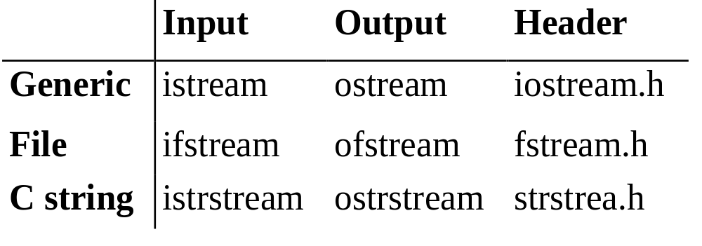
Stream naming conventions

Slide 73
Stream operations
Extractors
  Read a value from the stream
  Overload the >> operator
Inserters
  Insert a value into a stream
  Overload the << operator
Manipulators
  Change the stream state
Others

Slide 74
Predefined streams
cin
  standard input
cout
  standard output
cerr
  unbuffered error (debugging) output
clog
  buffered error (debugging) output

Slide 75
Example
#include <iostream.h>
int i; float f; char c;
char buffer[80];
Read the next character
  cin >> c;
Read an integer
  cin >> i; // skips whitespace
Read a float and a string separated by whitespace
  cin >> f >> buffer;

Slide 76
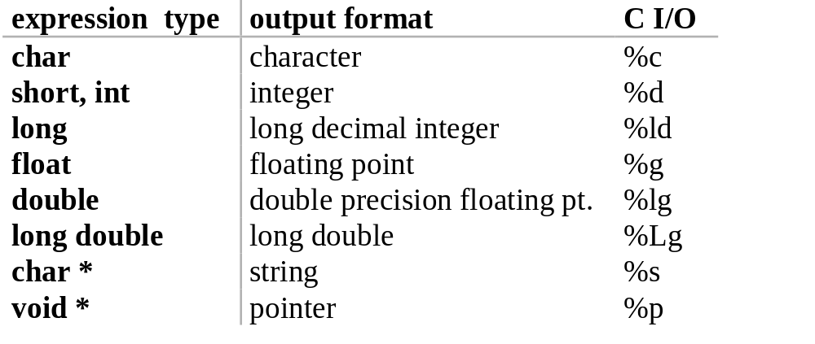
Predefined extractors
istream >> lvalue
Extractors skip leading whitespace, in general

Slide 77
Other input operators
int get()
    Returns the next character in the stream
    Returns EOF if no characters left
    Example: copy input to output
    int ch;
    while ((ch = cin.get()) != EOF) cout.put(ch);
istream& get(char& ch)
    Puts the next character into argument
    Similar to int get();

Slide 78
More input operators
get(char *buf, int limit, char delim = '\n')
    read up to limit characters, or to delim
    Appends a null character to buf
    Does not consume the delimiter
getline(char *buf, int limit,char delim = '\n')
    read up to limit characters, or to delim
    Appends a null character to buf
    Does consume the delimiter
ignore(int limit = 1, int delim = EOF)
    Skip over limit characters or to delimiter
    Skip over delimiter if found

Slide 79
More input operators
int gcount()
    returns number of characters just read
    char buffer[100];
    cin.getline(buffer, sizeof(buffer));
    cout << "read " << cin.gcount()
    << " characters"
void putback(char)
    pushes a single character back into the stream
char peek()
    examines next character without reading it
    switch (cin.peek()) ...

Slide 80
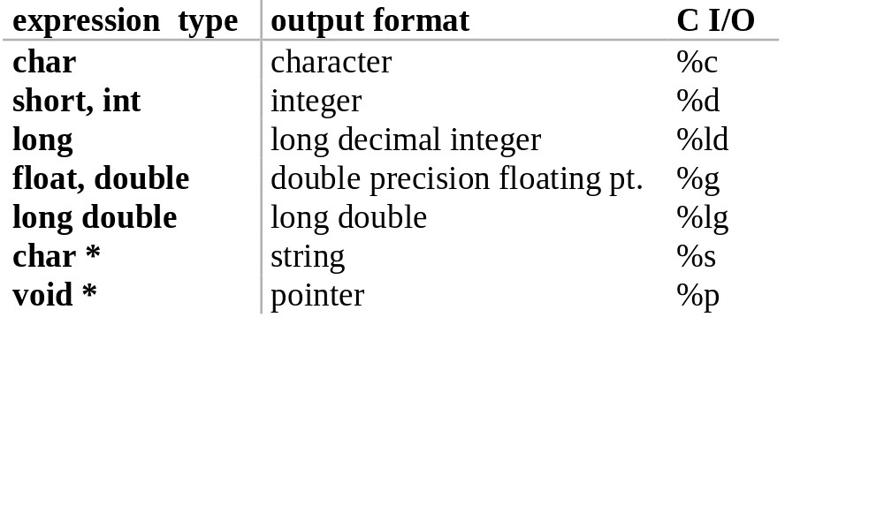
Predefined inserters
Usage
  ostream << expression

Slide 81
Other output operators
put(char)
    prints a single character
    Examples
    cout.put('a');
    cerr.put('!');
flush()
    Force output of stream contents
    Example
    cout << "Enter a number";
    cout.flush();

Slide 82
Formatting using manipulators
Manipulators modify the state of the stream
    #include <iomanip.h>
    Effects hold (usually)
Example
    cout << "enter number in hexadecimal"
    << flush;
    cin >> hex >> n;

Slide 83
Example
A simple program
  #include <iostream.h>
  #include <iomanip.h>
  main() {
    cout << setprecision(2) << 1000.243 <<endl;
    cout << setw(20) << "OK!";
    return 0;
  }
Prints
  1e03
  OK!

Slide 84
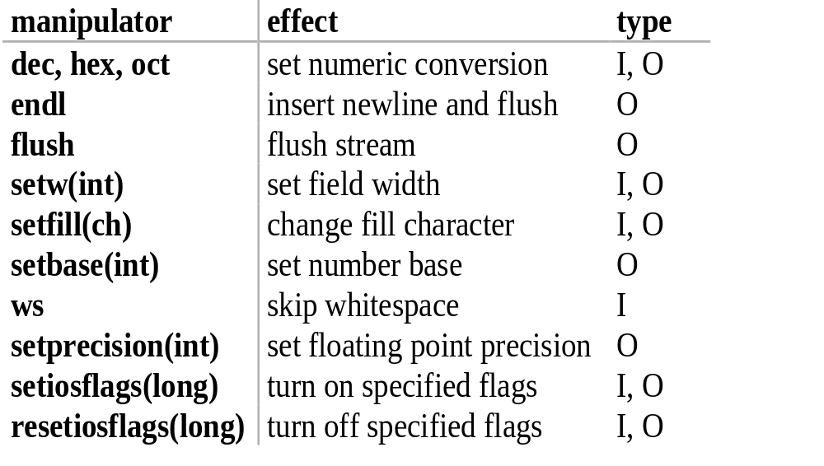
Manipulators

Slide 85
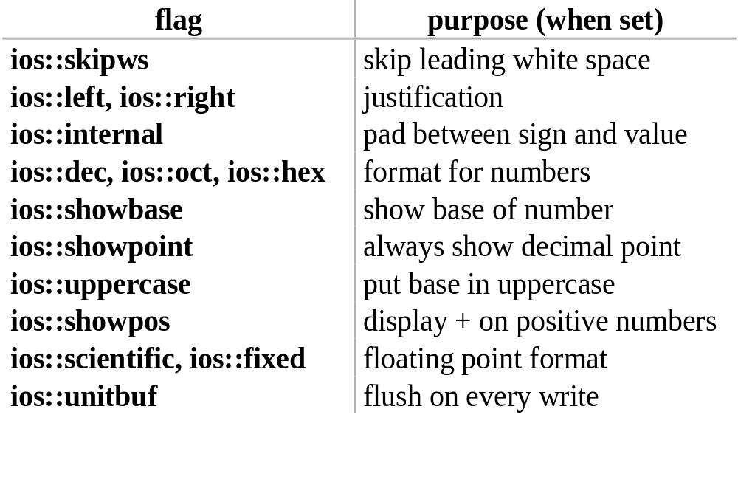
Stream flags control formatting

Slide 86
Setting flags
Using manipulators
  setiosflags(flags);
  resetiosflags(flags);
Using stream member functions
  setf(flags)
  unsetf(flags)

Slide 87
Working with flags
Code
  #include <iostream.h>
  #include <iomanip.h>
  main() {
    cout. setf(ios::showpos | ios::scientific);
    cout << 123 << " " << 456.78 << endl;
    cout << resetiosflags(ios::showpos) << 123;
    return 0;
  }
Prints
    +123 +4.567800e+02
    123

Slide 88
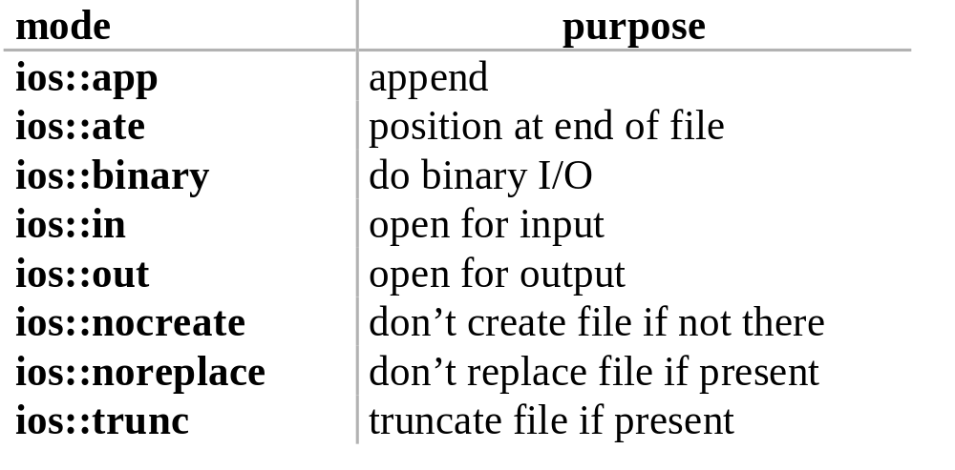
File streams
ifstream, ofstream connect files to streams
  #include <fstream.h>
  Open modes specify how to create files

Slide 89
File streams
#include <iostream.h>
#include <fstream.h>
int main(int argc, char *argv[]) {
  if (argc != 3) {
  cerr << "Usage: copy file1 file2" << endl;
  exit(1);
  }
  ifstream in(argv[1]);
  if (!in) {
  cerr << "Unable to open file " << argv[1];
  exit(2);
  }

Slide 90
File streams
  ofstream out(argv[2]);
  if (!out) {
  cerr << "Unable to open file " << argv[2];
  exit(2);
  }
  char c;
  while (in >> c) {
  out << c;
  }
}

Slide 91
More stream operations
open(const char *, int flags, int)
    Open a specified file
    ifstream inputS;
    inputS.open("somefile", ios::in);
    if (!inputS) {
    cerr << "Unable to open somefile";
    ...
close()
    Closes stream

Slide 92
Const keyword
Declares a variable to have a constant value
  const int x = 123;
  x = 27; // illegal!
  x++; // illegal!
  int y = x; // Ok, copy const to non-const
  y = x; // Ok, same thing
  const int z = y; // ok, const is safer

Slide 93
Compile time constants
C uses the preprocessor to define constants
  #define BUFSIZE 128
  Textual replacement
    BUFSIZE not visible to debugger
    Does not respect normal scoping rules
    int BUFSIZE = 48; // Syntax error!
C++ provides a better way
  const int BUFSIZE = 128;
  Value must be initialized
  Compiler won’t let you change it

Slide 94
Constants
Constants are just variables
  Observe scoping rules
  Declared with “const” type modifier
const value can be exploited
  const int class_size = 12;
  int finalGrade[class_size]; // ok
  int x;
  cin >> x;
  const int size = x;
  double classAverage[size]; // error!

Slide 95
Pointers and const
aPointer -- may be const
0xaffefado
aValue -- may be const
54
char * const q = "abc"; // q is const
  *q = 'c'; // OK
  q++; // ERROR
const char *p = "ABCD";
  // (*p) is a const char
  *p = 'b'; // ERROR! (*p) is the const

Slide 96
Conversions
Can always treat a non-const value as const
  void f(const int& x);
  int a = 15;
  f(a); // ok
  const int b = a;
  f(b); // ok
  b = a + 1; // Error!
You cannot treat a constant object as non-constant without an explicit cast (const_cast)

Slide 97
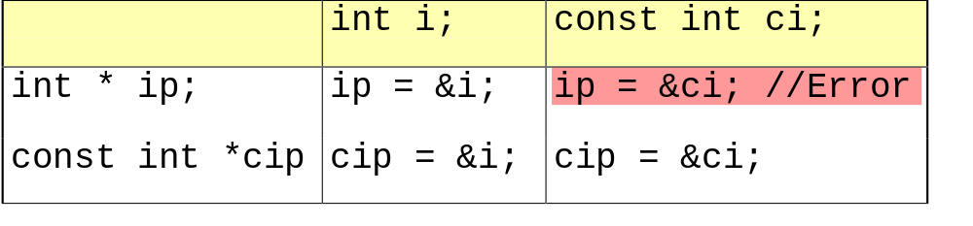
Pointers and constants
Remember:
*ip = 54; // always legal since ip points to int
*cip = 54; // never legal since cip points to const int

Slide 98
Temporary values are const
What you type
  void func(int &);
  func (i * 3); // Generates warning or error!
What the compiler generates
  void func(int &);
  const int tmp@ = i * 3;
  func(tmp@); // Problem -- binding const ref to
  // non-const argument!
The temporary is constant, since you can't access it

Slide 99
Constant objects
What if an object is const?
  const Currency the_raise(42, 38);
What members can access the internals?
How can the object be protected from change?
Solution: explicit blessing
  Programmer declares member functions to be safe

Slide 100
Example
  class Integer {
  private:
  int m_value;
  public:
  Integer(int v = 0);
  int value() const;
    void set_value(int v);
    };
Const after parameter list blesses the function

Slide 101
Const member functions
Can access constant and non-constant objects
  Integer size(48); // not a const
  int x = size.value(); // OK
  size.set_value(13); // OK
  const Integer thirteen(13);
  int x = thirteen.value(); // OK
  thirteen.set_value(14); // ERROR

Slide 102
Const member functions
Cannot modify their objects
  int Integer::set_value(int v) {
  { m_value = v; } // ok
  int Integer::value() const
  {
  m_value++; // illegal side effect
  set_value(12); // illegal call to non-const
  // member function
  return (m_value); // ok
  }

Slide 103
Mutable member variables
Const member functions can’t change their objects
What if they have to?
    Logical constants vs. bitwise constants
    Adaptive data structures
Solution: the “mutable” keyword
  mutable int somevar;
  Mutable members can be changed by const member functions!
  Only class members can be mutable

Slide 104
Compile-time constants in classes
  class HasArray {
    const int size;
    int array[size]; // ERROR! (const value must be
    // static inside the class OR...
    ...
    };
Use "anonymous enum" hack
  class HasArray {
    enum { size = 100 };
    int array[size]; // OK!
    ...
    };

Slide 105
Const usage
Const is enforced by the compiler
  It looks for assignments to member variables
  You can construct the object without problem
Use const whenever appropriate
  Be consistent:
    Use it always
    Use it never
    In-between will drive you nuts!
The const modifier on a function influences overload resolution, just like the argument types

Slide 106
Function macros
Macro expands textually
  #define twice(a) ((a) + (a))
  twice(x * y) => ((x * y) + (x * y))
  twice(x++) => ((x++) + (x++))
No type checking!
  #define print(a) printf("%d", a);
  float x;
  print(x);

Slide 107
Inline functions: an alternative
Standard functions require a call
Inline functions do not require a function call
  Instead, their body is copied into the point of call
Standard Case
Inline Case
// Call f
y = f(x);
print(y);
// Call f
print(y);
int f(int a)
body
return v;
{
int a = x;
body
y = v;
}

Slide 108
Inline functions in C++
inline int
twice(int x) {
return x + x;
}
inline void
print(int x) {
printf("%d", x);
}
Semantics are the same as for non-inline functions
  Arguments are evaluated correctly!

Slide 109
Declaring inline functions
Inline functions have internal linkage
  Defined in header file or before use
Using the inline keyword
  inline int Currency::dollars() const { … }
Providing the definition in the class definition
  class Currency {
    int dollars() const {
    return m_totalcents / 100;
    }
    …
  };

Slide 110
Inlines and ordering: Free lunch!
Declaration before use relaxed for inlines in class
  m_x, m_y appear in function body before declaration
  class A {
  public:
    // A() refers to fields not yet declared
    A() { m_x = 3; m_y = 3.14; }
    void print();
  private:
    int m_x;
    float m_y;
  };

Slide 111
Using inline functions
Definition (body) must be visible prior to first use
  Otherwise, compiler generates a call
  Most inlines will appear in header file
Inlines have “internal” linkage
  May get redundant copies in each compilation unit
Issues:
  Some compilers are highly restrictive
  Code bloat
Inline is a hint, not a command

Slide 112
Linkage
A name has external linkage if it is visible outside the compilation unit
  External names interact at link time!
  Non-static, non-inline free functions
  Global (non-static) variables
  Non-inline member functions
A name has internal linkage if it is not visible outside the compilation unit.
  enums, typedefs, class definitions, static free functions
  inline functions

Slide 113
extern
Declares a variable
  extern int g_somewhere;
Does not allocate space for the variable
Uses:
  Share variables among files
  Linker makes the necessary connections

Slide 114
Externs visible outside file
File1
File2
int g_global;
void
func() {
...
}
extern int g_global;
void func();
int
myfunc() {
g_global += 2;
func();
}

Slide 115
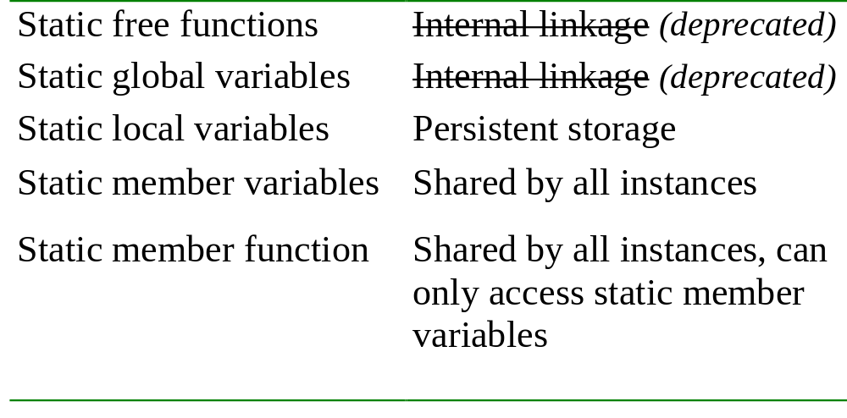
Uses of “static” in C++

Slide 116
Global statics hidden in file
File1
File2
int g_global;
static int s_local;
void
func() {
...
}
static
void
hidden() { ...}
extern int g_global;
void func();
extern int s_local;
int
myfunc() {
g_global += 2;
s_local *= g_global;
func();
}
?

Slide 117
Static inside functions
Value is remembered for entire program
Initialization occurs only once
Example:
  count the number of times the function has been called
  void f() {
  static int num_calls = 0;
  ...
  num_calls++;
  }

Slide 118
Static applied to objects
Suppose you have a class
  class X {
  X(int, int);
  ~X();
  ...
  };
And a function with a static X object
  void f() {
  static X my_X(10, 20);
  ...
  }

Slide 119
Construction occurs when definition is encountered
  Constructor called at-most once
  The constructor arguments must be satisfied
Destruction takes place on exit from program
  Compiler assures LIFO order of destructors

Slide 120
Conditional construction
Example: conditional construction
  void f(int x) {
  if (x > 10) {
  static X my_X(x, x * 21);
  ...
  }
my_X
  is constructed once, if f() is ever called with x > 10
  retains its value
  destroyed only if constructed

Slide 121
Global objects
Consider
  #include "X.h"
  X global_x(12, 34);
  X global_x2(8, 16)
Constructors are called before main() is entered
  Order controlled by appearance in file
  In this case, global_x before global_x2
  main() is no longer the first function called
Destructors called when
  main() exits
  exit() is called

Slide 122
Global constructors
Order of construction within a file is known
Order between files is unspecified!
Three solutions
  Don't do that!
  Call a specific initialization function
  Use the Schwartz technique
    Add unique initializer class
    Create initializer in each file

Slide 123
Can we apply static to members?
Static means
  Hidden
  Persistent
Hidden: A static member is a member
  Obeys usual access rules
Persistent: Independent of instances
Static members are class-wide
  variables or
  functions

Slide 124
Static members
Static member variables
  Global to all class member functions
  Initialized once, at file scope
Static member functions
  Have no implicit receiver ("this")
    (why?)
  Can access only static member variables
    (or other globals)
  Can’t be dynamically overridden

Slide 125
Overloaded operators
Unary and binary operators can be overloaded
  Examples: +, *, ->, ==, ++, +=
  Exception: the dot operator "." as in a.b
    also .*, ->, and ?:
Restrictions
  You can’t change how they act!
    Preserve number of operands
    Preserve precedence
    Preserve associativity

Slide 126
C++ overloaded operators
Just a function with an operator name!
  Use the operator keyword as a prefix to name
  operator *(...)
Can be a member function
  Implicit first argument
  String operator +(const String&);
Can be a global (free) function
  Both arguments explicit
  ostream& operator<<(ostream&, const String&);

Slide 127
How to overload
As member function
  Implicit first argument
  No type conversion performed on receiver
  Must have access to class definition
As free function
  Explicit first argument
  Type conversions performed on both arguments
  Need not be member of class
    Example: stream operations

Slide 128
Operators as member functions
class X {
public:
  X operator+(const X&) const;
};
  X aa, bb;
  aa + bb ====> aa.operator+(bb);
Implicit first argument
Developer must have access to class definition
Members have full access to all data in class
No type conversion performed on receiver

Slide 129
Operator as a free function
X operator+(const X&, const X&);
  X aa, bb;
  aa + bb ====> operator+(aa, bb);
Explicit first argument
Developer does not need special access to classes
May need to be a friend
Type conversions performed on both arguments

Slide 130
Defining a stream extractor
Has to be a 2-argument free function
  First argument is an istream&
  Second argument is a reference to a value
  istream&
  operator>>(istream& is, T& obj) {
    // specific code to read obj
    return is;
  }
Return an istream& for chaining
  cin >> a >> b >> c;
  ((cin >> a) >> b) >> c;

Slide 131
Creating a stream inserter
Has to be a 2-argument free function
  First argument is an ostream&
  Second argument is any value
  ostream&
  operator<<(ostream& os, const T& obj) {
    // specific code to write obj
    return os;
  }
Return an ostream& for chaining
  cout << a << b << c;
  ((cout << a) << b) << c;

Slide 132
Inheritance
Language implementation technique
Also an important component of the OO design methodology
Allows sharing of
  Member data
  Member functions
  Interfaces
Key technology in C++

Slide 133
Inheritance
The ability to define the behavior or implementation of one class as a superset of another class
Employee
Manager

Slide 134
Declare an Employee class
class Employee {
public:
enum PayPeriod {hourly,weekly,monthly };
Employee(const String&, const String&,
const Currency&, PayPeriod = hourly);
Currency compute_pay();
void print(ostream&);
protected:
String m_name;
String m_soc_sec;
Currency m_salary;
PayPeriod m_payPeriod;
friend class Manager; //Convoluted example!
};

Slide 135
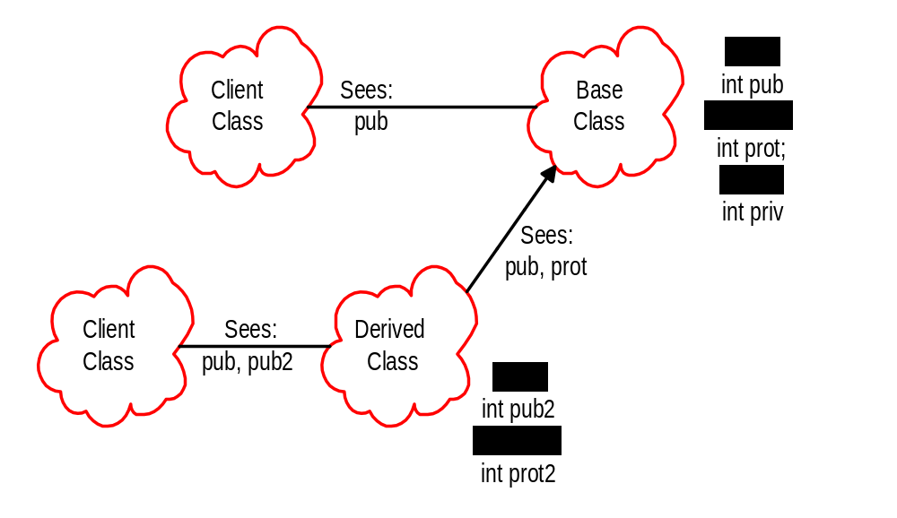
Scopes and access in C++

Slide 136
Constructor for Employee
Employee::Employee(const String& nam,
const String& ssno,
const Currency& sal,
PayPeriod per)
: m_name(nam), m_soc_sec(ssno),
m_salary(sal), m_period(per) {
// initializer list sets up the values!
}

Slide 137
Now add Manager
class Manager : public Employee {
private:
  Employee *m_assistant;
public:
  Manager(const String&, const String&,
  const Currency&);
  ~Manager();
  void raise(Employee&, const Currency&);
  void set_assistant(Employee*);
};

Slide 138
Uses
int
main() {
Employee bob("Bob Jones", "55511222", Currency(3,45));
Manager bill("Bill Thomas", "345129871",
Currency(20000,0));
Currency bobs_sal = bob.compute_pay();
// OK -- Manager inherits from Employee
Currency bills_sal = bill.compute_pay();
bill.raise(bob, Currency(0, 50)); // Ok
bob.raise(bob, Currency(5000, 0)); // Error!
bill.raise(bill, Currency(5000, 0)); // Ok
}

Slide 139
Implementing raise()
void Manager::raise(Employee& e, Currency& c) {
// This uses the client interface, so e's salary
// has to be accessible
e.m_salary = c;
};

Slide 140
Inheritance and constructors
Think of inherited traits as an embedded object
Base class is mentioned by class name
  Manager::Manager(const String& name,
  const String& ssno,
  const Currency& salary)
  :Employee(name, ssno, salary, Employee::monthly),
  m_assistant(0)
  {
  }

Slide 141
More on constructors
Base class is always constructed first
If no explicit arguments are passed to base class
  Default constructor will be called

Slide 142
What is not inherited?
Constructors
Destructors
Assignment operation
Private data is hidden, but still present
Friends

Slide 143
A drawing program
Rectangle
Circle
Ellipse
Operations
- render
- move
- resize
Data
+ center

Slide 144
Without inheritance
typedef enum { RECT, CIRC, ELLIPSE } ShapeType;
typedef struct {
ShapeType tag;
XYPos center;
union {
struct square_rect rect;
struct ellipse_info ellipse;
struct circle_info circle;
} shape_info;
} Shape;

Slide 145
Worse...
void
render(Shape *p) {
switch (p->tag) {
case CIRCLE:
render_circle(p->circle_info);
break;
case RECT:
render_rect(p->rect_info);
...
What if you add a new shape? A new operation?

Slide 146
Inheritance in C++
Can define one class in terms of another
Can capture the notion that
  An ellipse is a shape
  A circle is a special kind of ellipse
  A rectangle is a different shape
  Circles, ellipses, and rectangles share common
    attributes
    services
  Circles, ellipses, and rectangles are not identical
Ellipse
Shape
Circle

Slide 147
Conceptual model
center
move()
render()
Shape
Rectangle
render()
Ellipse
render()
Square
Circle
render()
render()
Note: Deriving Circle from Ellipse is a poor design choice!

Slide 148
In C++
Define the general properties of a Shape
class Shape {
public:
Shape();
virtual ~Shape();
virtual void render();
void move(const XYPos&);
virtual void resize();
protected:
XYPos center;
};

Slide 149
Program in terms of shapes
void
redraw(Shape* shapes[], int num_shapes) {
for (int i = 0; i < num_shapes; i++) {
// send shape[i] the render message
shapes[i]->render();
}
}

Slide 150
Virtual functions
Non-virtual functions
  Compiler generates static, or direct call to stated type
  Faster to execute
Virtual functions
  Can be transparently overridden in a derived class
  Objects carry a pack of their virtual functions
  Compiler checks pack and dynamically calls the right function
  If compiler knows the function at compile-time, it can generate a static call

Slide 151
Add new shapes
class Ellipse : public Shape {
public:
Ellipse(float maj, float minr);
virtual void render(); // will define own
protected:
float major_axis, minor_axis;
};
class Circle : public Ellipse {
public:
Circle(float radius) : Ellipse(radius, radius){}
virtual void render();
};

Slide 152
Example
void func(int flag) {
Ellipse ell(10, 20);
ell.render(); // static -- Ellipse::render();
Circle circ(40);
circ.render(); // static -- Circle::render();
render(&ell); // dynamic -- Ellipse::render();
render(&circ); // dynamic -- Circle::render()
}
void render(Shape* p) {
p->render(); // calls correct render function
} // for given Shape!

Slide 153
Abstract base classes
An abstract base class has pure virtual functions
  Only interface defined
  No function body given
Abstract base classes cannot be instantiated
  Must derive a new class (or classes)
  Must supply definitions for all pure virtuals before class can be instantiated

Slide 154
In C++
Define the general properties of a Shape
class Shape {
public:
Shape();
virtual void render() = 0; // mark render() pure
void move(const XYPos&);
virtual void resize();
protected:
XYPos center;
};

Slide 155
Abstract classes
Why use them?
  Modeling
  Force correct behavior
  Define interface without defining an implementation
When to use them?
  Not enough information is available
  When designing for interface inheritance

Slide 156
How virtuals work in C++
class Shape {
public:
Shape();
virtual ~Shape();
virtual void render();
void move(const XYPos&);
virtual void resize();
protected:
XYPos center;
};
A Shape
vtable
center
Shape vtable
Shape::dtor()
Shape::render()
Shape::resize()

Slide 157
Ellipse
class Ellipse :
public Shape {
public:
Ellipse(float majr,
float minr);
virtual void render();
protected:
float major_axis;
float minor_axis;
};
An Ellipse
vtable
center
major_axis
Ellipse vtable
minor_axis
Ellipse::dtor()
Ellipse::render()
Shape::resize()

Slide 158
Circle
class Circle :
public Ellipse {
public:
Circle(float radius);
virtual void render();
virtual void resize();
virtual float radius();
protected:
float area;
};
A Circle
vtable
center
major_axis
Circle vtable
minor_axis
area
Circle::dtor()
Circle::render()
Circle::resize()
Circle::radius()

Slide 159
What happens if
  Ellipse elly(20F, 40F);
  Circle circ(60F);
  elly = circ; // 10 in 5?
Area of circ is sliced off
  (Only the part of circ that fits in elly gets copied)
Vtable from circ is ignored; the vtable in elly is the Ellipse vtable
  elly.render(); // Ellipse::render()

Slide 160
What happens with pointers?
  Ellipse* elly = new Ellipse(20F, 40F);
  Circle* circ = new Circle(60F);
  elly = circ;
Well, the original Ellipse for elly is lost....
elly and circ point to the same Circle object!
  elly->render(); // Circle::render()

Slide 161
Virtuals and reference arguments
  void func(Ellipse& elly) {
  elly.render();
  }
  Circle circ(60F);
  func(circ);
References act like pointers
Circle::render() is called

Slide 162
Virtual destructors
Make destructors virtual if they might be inherited
  Shape *p = new Ellipse(100.0F, 200.0F);
  ...
  delete p;
Want Ellipse::~Ellipse() to be called
  Must declare Shape::~Shape() virtual
  It will call Shape::~Shape() automatically
If Shape::~Shape() is not virtual, only Shape::~Shape() will be invoked!

Slide 163
Overriding
Overriding redefines the body of a virtual function
  class Base {
  public:
    virtual void func();
  }
  class Derived : public Base {
  public:
    virtual void func();
    //overrides Base::func()
  }

Slide 164
Calls up the chain
You can still call the overridden function:
void
Derived::func() {
cout << "In Derived::func!";
Base::func(); // call to base class
}
This is a common way to add new functionality
No need to copy the old stuff!

Slide 165
Overloading and virtuals
Overloading adds multiple signatures
  class Base {
    public:
      virtual void func();
      virtual void func(int);
    };
If you override an overloaded function, you must override all of the variants!
  Can't override just one
  If you don't override all, some will be hidden

Slide 166
Overloading example
When you override an overloaded function, override all of the variants!
  class Derived : public Base {
    public:
      virtual void func() {
      Base::func();
      }
      virtual void func(int) { ... } ;
    };

Slide 167
Access protection
Members
  Public: visible to all clients
  Protected: visible to classes derived from self
  (and to friends)
  Private: visible only to self and to friends!
Inheritance
  Public: class Derived : public Base ...
  Protected: class Derived : protected Base ...
  Private: class Derived : private Base ...

Slide 168
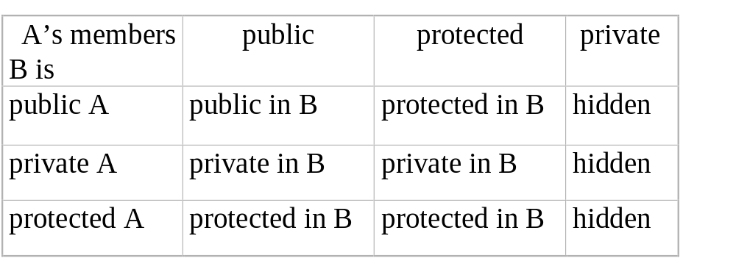
How inheritance affects access
Suppose class B is derived from A. Then

Slide 169
Using inheritance
Public inheritance models “isa”
  Is substitution valid?
Distinguish inheritance of interface and inheritance of implementation.
  Interfaces are always inherited
  Pure virtuals restrict inheritance to interfaces
  Simple (non-pure) virtuals provide a default implementation
  Non-virtual functions provide a mandatory implementation

Slide 170
Tips
Never redefine an inherited non-virtual function
  Non-virtuals are statically bound
  No dynamic dispatch!
  UNLESS you use scope resolution and add behavior
Never redefine an inherited default parameter value
  They’re statically bound too!
  And what would it mean?

Slide 171
Tips
Avoid casts down the inheritance hierarchy
  “Casts are to C++ as the apple was to Eve” (Meyers)
  New-style casts solve some of this problem
    Base* bp;
    ...
    Derived* dp = dynamic_cast<Derived*>(bp);
    if (dp == 0) {
      // bad cast!
    }
  Often, the fix is to introduce a virtual function higher in the hierarchy

Slide 172
Multiple assignment
a = b; // copy members of a to b, all okay
a = a; // no need to do any work here
a = b = c; // multiple assignment
a = b = c; means a = (b = c);
The first operation, b = c, must return a new version of b, so that a can be set to b.
The function returns a variable of its same type as its LHS.

Slide 173
Returning self-reference
IntArray& IntArray ::operator=(const IntArray& rtSide) {
if (this == rtSide) return *this;
// do what assignment means here...
return *this;
}
The self-referential pointer is dereferenced and passed back as the value of the expression.
This allows multiple assignment with right-to-left associativity to be defined.

Slide 174
Strange things
The overloaded operator can be used in chains of assignments, like:
a = b = c;
(a = b).someMemberFunction();
What if the class’s overloaded operator modified the underlying storage (allocated a new size for an array, for example)?

Slide 175
